Slide 1
Daily Review
Types of Ecological Pyramids
Upright pyramid of numbers shows how many organisms are at each trophic level and has many producer organisms.
Inverted pyramid of numbers also shows how many organisms are at each trophic level, but has one producer organism.
Pyramid of energy shows how much energy is available at each trophic level.
Draw an energy pyramid that has rabbits, hawks, grass and snakes. There is 20kJ of energy in the snake’s trophic level.

Slide 2
Daily Review
Types of Ecological Pyramids
Upright pyramid of numbers shows how many organisms are at each trophic level and has many producer organisms.
Inverted pyramid of numbers also shows how many organisms are at each trophic level, but has one producer organism.
Pyramid of energy shows how much energy is available at each trophic level.
Draw an ecological pyramid that shows 200 caterpillars feeding off one tree, supporting 50 small birds and 1 cat.

Slide 3
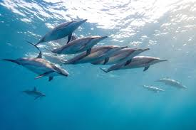
Daily Review
Relationships Between Organisms
Describing Relationships
Use the flow chart to identify the relationship Use the words in the flow chart to describe the relationship
Same Species
Different Species
Helping the species survive
Fighting for resources
Short term
Long term
Working together
Producing offspring
One hunting another
Both benefit
One benefits
One is harmed
A pod of dolphins surrounds a school of fish. Describe the relationship between dolphins and the fish.
Collaboration
Competition
Mutualism
Parasitic
Mating
Predator-Prey
Commensalism
This relationship is predator-prey. It is a short term relationship between organisms of different species. One hunts the other.

Slide 4
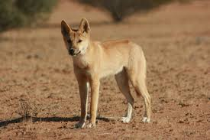
Daily Review
Relationships Between Organisms
Describing Relationships
Use the flow chart to identify the relationship Use the words in the flow chart to describe the relationship
Same Species
Different Species
Helping the species survive
Fighting for resources
Short term
Long term
Working together
Producing offspring
One hunting another
Both benefit
One benefits
One is harmed
Dingoes and foxes both feed on rabbits. Describe the relationship between a dingo and a fox.
Collaboration
Competition
Mutualism
Parasitic
Mating
Predator-Prey
Commensalism
This is an example of competition. It is a short term relationship between different species where they are both fighting for the same resource.

Slide 5
Disruptions to Ecosystems

Slide 6
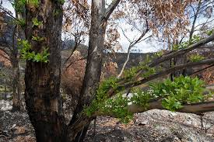
Learning Objectives
CFU
What are we going to learn?
Identify disruptions to ecosystems as natural or due to human activity.
Complete a graphic organiser summarising disruptions to ecosystems.
Activate Prior Knowledge
The picture shows an ecosystem after a bushfire.
Pair, Share: How has the bushfire caused damage to this ecosystem?
Pair, Share: How has the bushfire helped this ecosystem?

Slide 7
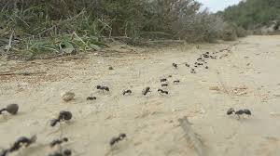
Concept Development
CFU 1
What is a population?
Populations and Communities
A population is a group of the same species living in the same place at the same time.
For example, a group of ants living in an ant hill.
A community is different populations living in the same place at the same time.
For example, a population of ants and a population of echidnas living in the same area,
CFU 2
What is a community?
CFU 3
How is a population different to a community?
CFU 4
Give an example of a population and a community in the ocean.

Slide 8
Concept Development
CFU 1
Think, pair, share: What are some other natural disruptions to ecosystems?
Disruptions to Ecosystems
Natural events and human activity can have a short-term or long-term impact on natural ecosystems.
Natural disruptions include floods and bushfires.
Habitat destruction and pollution are some human activities that cause disruptions.
A disruption may affect a particular population of organisms within the ecosystem or affect the community as a whole.
For example, releasing foxes into an ecosystem will affect the population of rabbits most directly.
CFU 2
Think, pair, share: What are some other human activities that cause disruptions to ecosystems?

Slide 9
Skill Development/Guided Practice
CFU 1
What goes in the innermost segment?
Filling Out the Graphic Organiser
Use the information on the cards to complete the graphic organiser.
In the innermost segment, write the name of the disruption, for example “Floods”
In the second segment, write the definition of floods.
CFU 2
What goes in the second segment?
An overflow of water onto dry land
Floods

Slide 10
Skill Development/Guided Practice
CFU 1
What goes in the third segment?
Filling Out the Graphic Organiser
Use the information on the cards to complete the graphic organiser.
In the third segment, describe some of the impacts of the disruption.
In the outermost segment, write some specific examples. (you may need to do some research)
CFU 2
What goes in the outermost segment?
Specific examples
Description of the impacts of the disruption
An overflow of water onto dry land
Floods

Slide 11
Relevance
Ecosystems are complex interactions between organisms and their surroundings.
Knowing about how ecosystems can be disrupted will help you understand how the size of populations in ecosystems are influenced and can change.

Slide 12
Skill Closure
Explain the difference between a population and a community.
Skill Closure
Classify these disruptions as being natural or due to human activity.
Seasons Bushfire
Introduced species Pollution
Floods Habitat destruction
Overhunting Drought

Slide 13
Independent Practice
Complete the graphic organiser on Disruptions to Ecosystems on a paper copy.
The four natural disruptions are: floods, drought, seasonal changes and bushfire.
The four human activities are: habitat destruction, introduced species, pollution and overhunting.
Marigold
Rafflesia
Specific examples
Trumpet Vine
Cactus
Jasmine
Bottlebrush
Description of the impacts of the disruption
An overflow of water onto dry land
Floods

